Slide 1
Acadedge
Software design specification (sds)

Slide 2
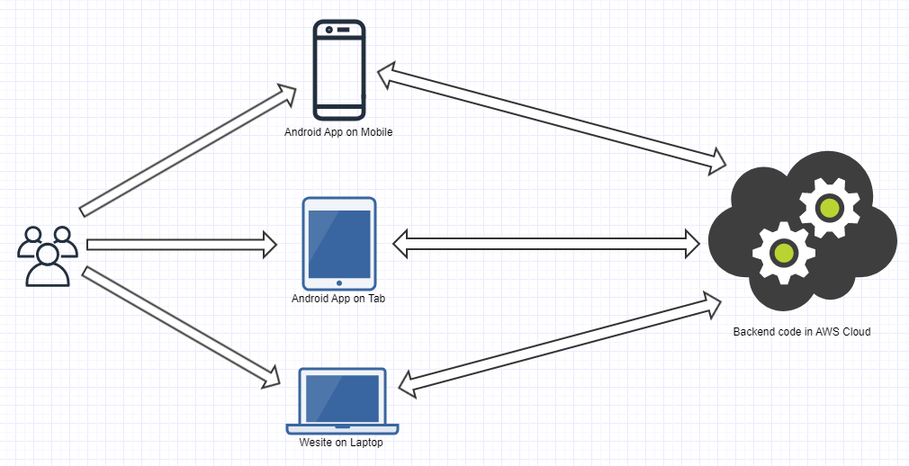
Solution Architecture

Slide 3
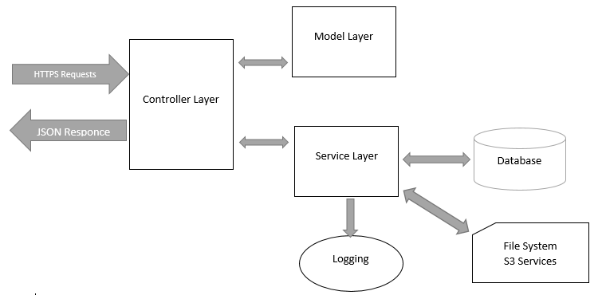
Web App (Backend)

Slide 4
Web App (Cont.)
Architecture: MVC
Technology: Spring Boot
Language: Java
Database: MySQL
Deployment: Amazon Web Services (AWS)
Description:
The web app/web service will be responsible to store, update and send all the user/admin data to/from the database. The service will be deployed on an AWS EC2 instance and will be 24x7 available and scalable in future. The web app encapsulates all the business logic of the entire solution while the website and mobile apps will be for user interaction.

Slide 5
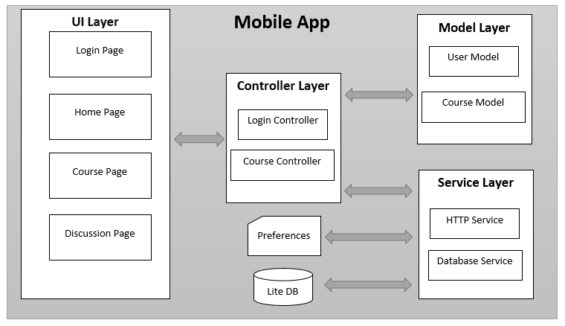
Mobile App
Web Service on AWS

Slide 6
Mobile App (Cont.)
Architecture: MVC, BLoC
Technology: Flutter
Language: dart
Description:
The mobile apps will first do user authentication and then will display logged in user’s customized data. The app will use HTTPS requests to send data to the server and will receive responses/results in JSON format. The app will also use a lite database on the mobile to store possible information to show while disconnected from internet.

Slide 7
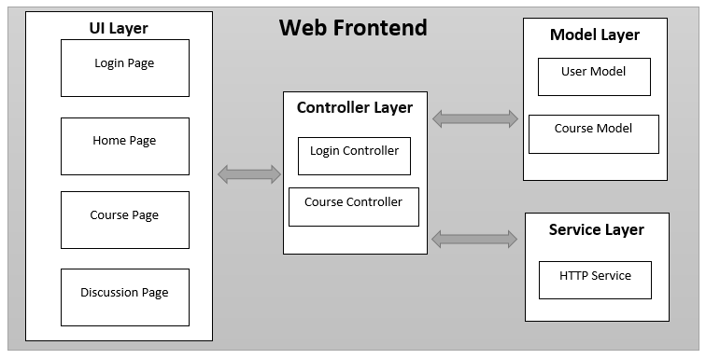
Web Frontend
Web Service on AWS

Slide 8
Web Frontend (Cont.)
Architecture: MVC, Reactive
Technology: Angular
Language: TypeScript
Description:
The website will have a home page to display free contents which doesn’t need user authentication. User will have to be authenticated to get customized data. The angular app will use HTTPS requests to send data to the server and will receive responses/results in JSON format.

Slide 9
Feedback?

